Slide 1
Dynatrace Unbreakable Pipeline
GKE, Jenkins

Slide 2
Key blue print – unbreakable continuous delivery model
Automate operations (self-healing) – auto-mitigate bad deployments in production
Self Healing
Shift right /
Deployment Speed
Automate deployment (shift-right) – push “monitoring-as-code” for auto-validation and auto-alerting
Shift left /
Quality gates
Automate quality (shift-left) – automate the pipeline and stop bad code changes before they reach prod
Multi-platform monitoring
Automate monitoring – use monitoring strategically as feature of the end-to-end pipeline

Slide 3
What we will accomplish
Deploying the SockShop application to our GKE cluster
Setting up Jenkins on K8s in GKE
Import a Jenkins Pipeline
Setup Dynatrace Integration with Jenkins
Using Jenkins Plugin and Monspec
Deploy different code builds and test their performance
Fail pipeline if code is not performant based on monspec

Slide 4
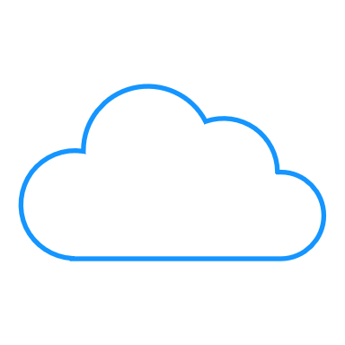
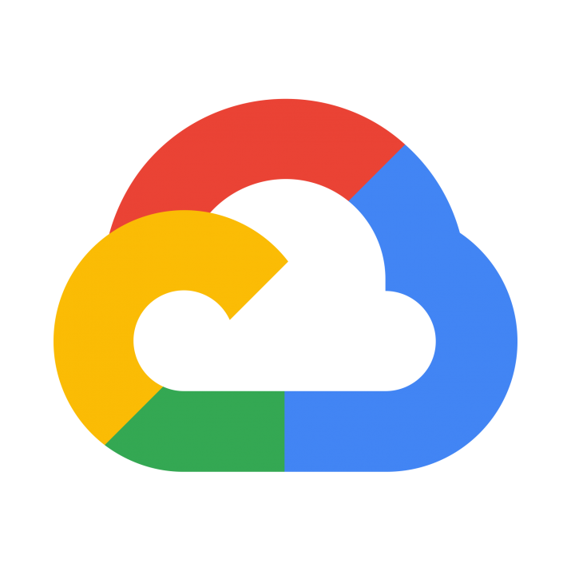
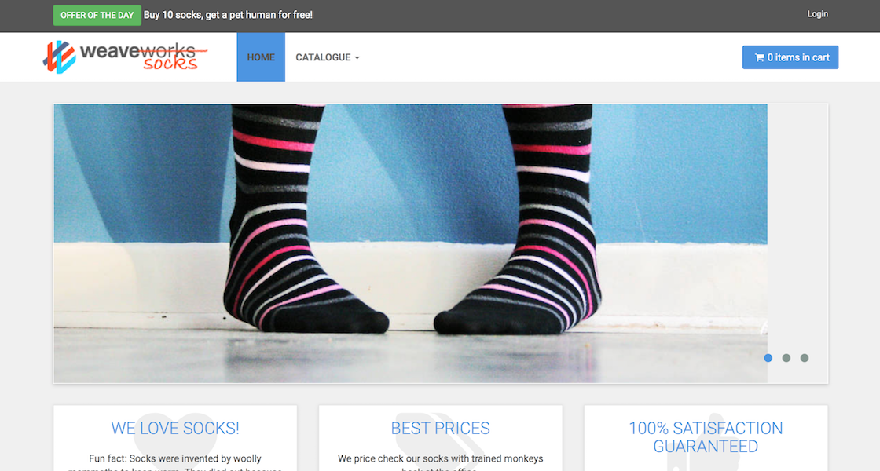


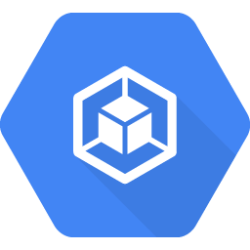
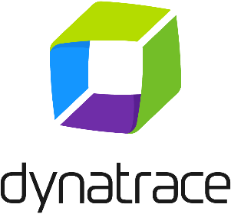
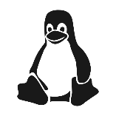

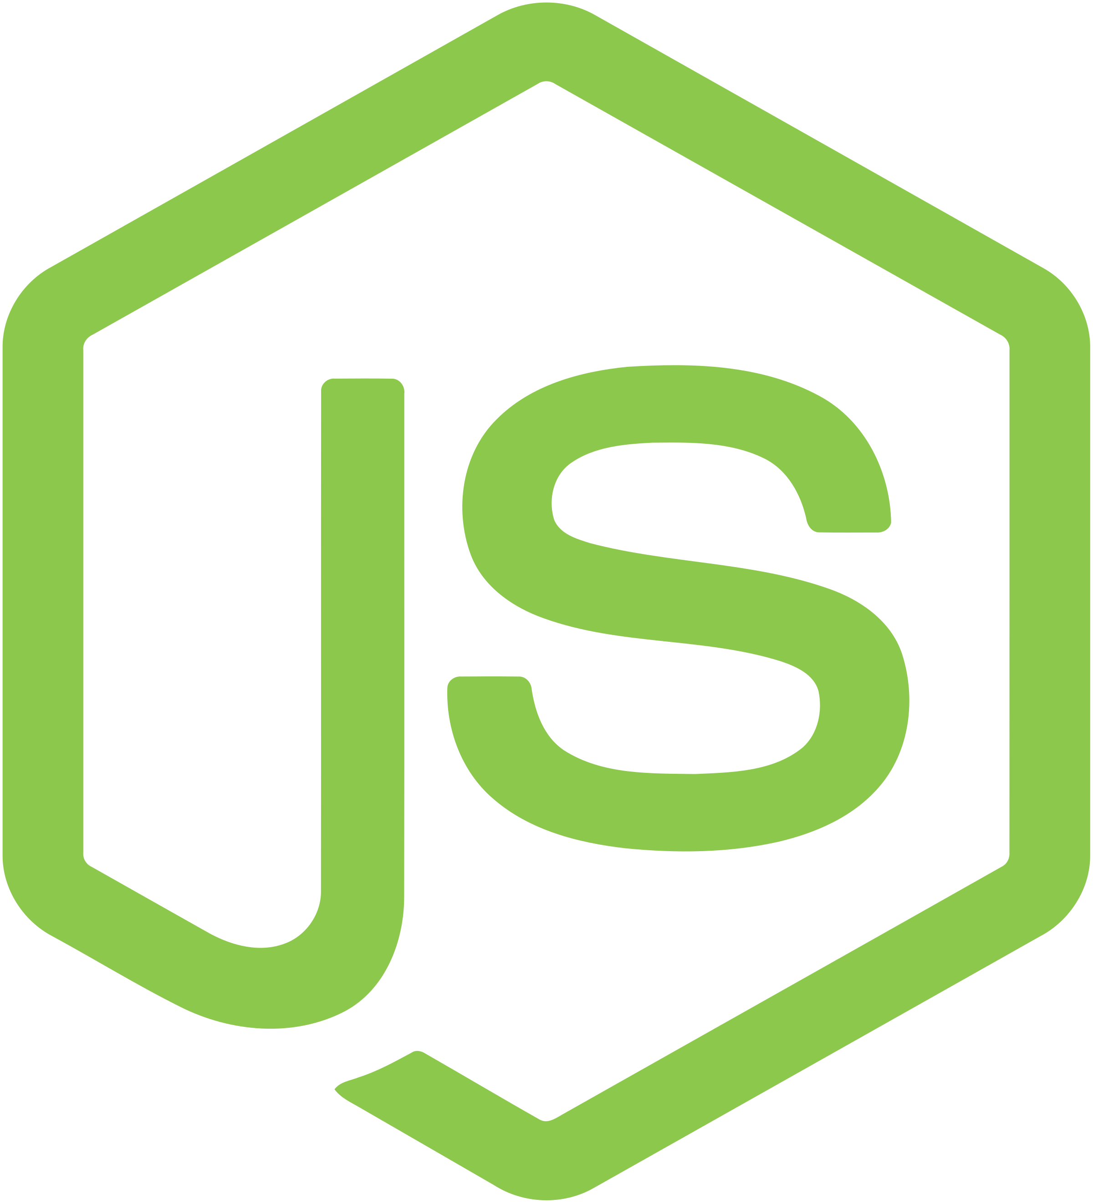
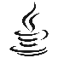
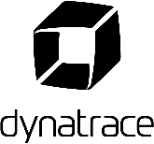
Workshop Setup
SampleApp
GitHub Repository
#2 Download Repo
#1 Create Dynatrace Tenant
#3 Deploy Jenkins
Every Team
On a laptop (or via CloudShell)
K8s
Jenkins
GKE Instances

Slide 5
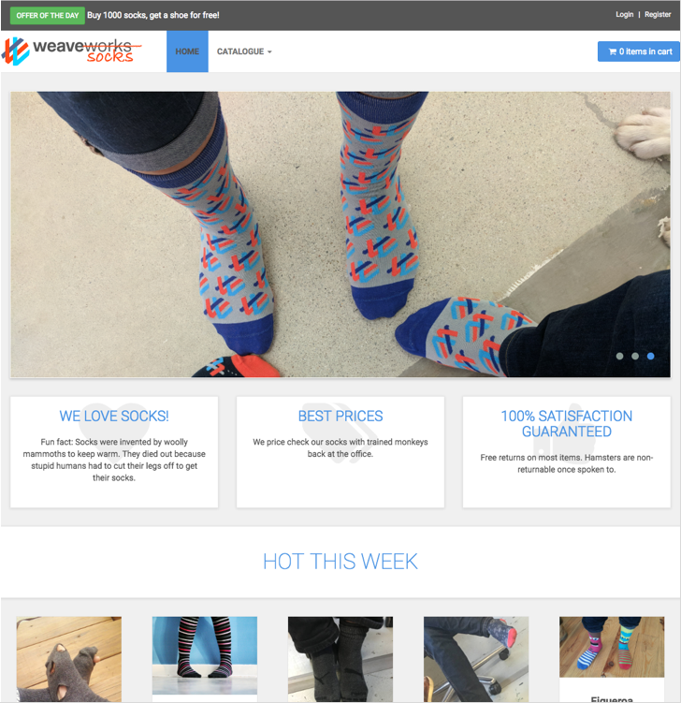
Sock Shop Application
Based on: http://socks.weave.works
Opensource microservice sample app
Polyglot
Java Spring Boot
Go
Node.js
RabbitMQ (order queuing)
MongoDB, MySQL (data stores)

Slide 6
Sock Shop architecture

Slide 7
Jenkins
The Worlds most advanced BASH terminal
In most cases it’s fine to deploy to K8s via simple kubectl commands in k8s
Most of deployments probably done this way
Spoiler Alert: We’re going to be doing this today
No true “easy” way to determine a failure or if app is up and running
$kubectl wait –n dev deploy/myapp –-for condition=available
This won’t catch pods that didn’t actually come online

Slide 8
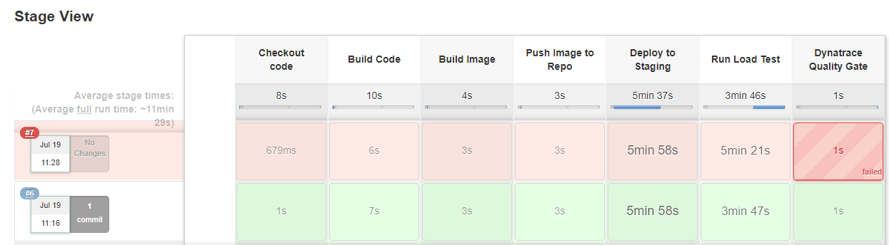
What our Pipeline will look like (hopefully)

Slide 9
Let’s Start the fun

Slide 10
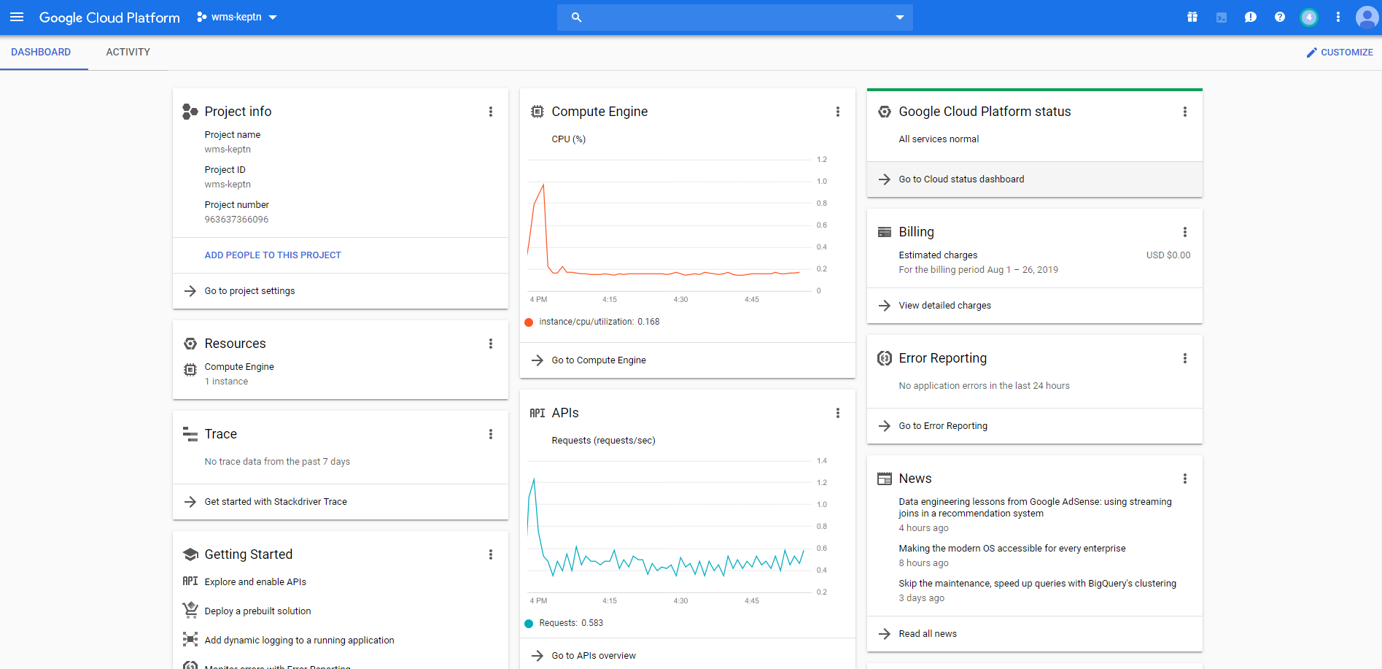
Setup our GKE Cluster
Login to your GCP Account

Slide 11
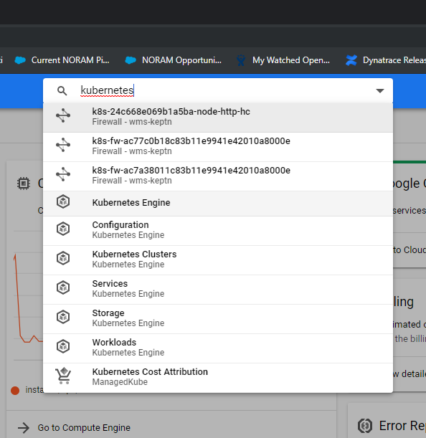
Setup our GKE Cluster
In the search box, type “Kubernetes” and select
“Kubernetes Engine” from the search results
This may take a few minutes if this is the first time you
are attempting to launch Kubernetes in this account.

Slide 12
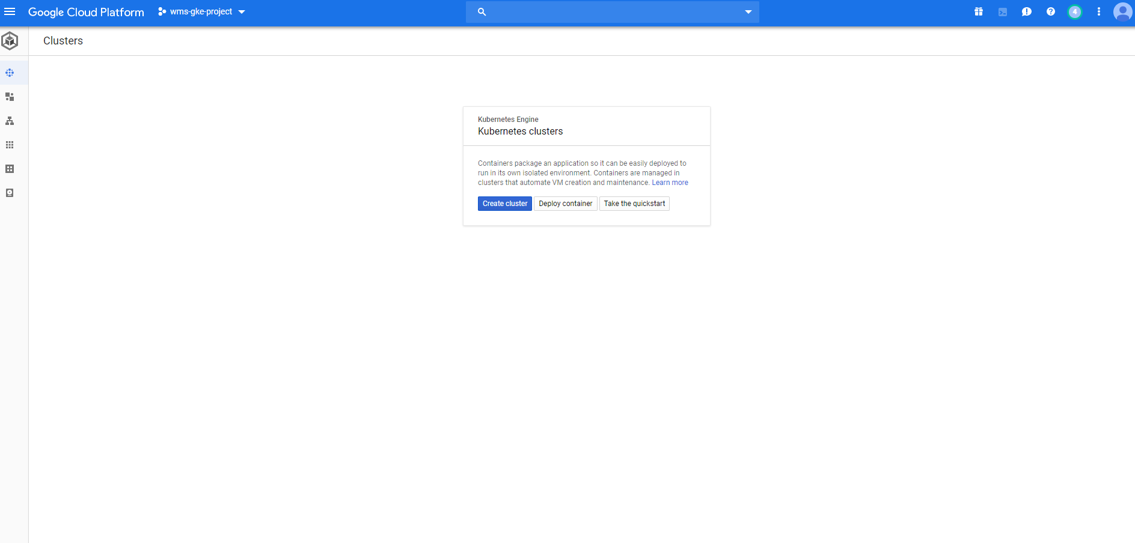
Setup our GKE Cluster
After the initial APIs are setup, your Kubernetes Engine screen should look like this (unless you already have an existing cluster setup)

Slide 13
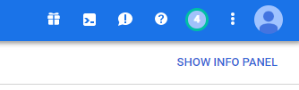
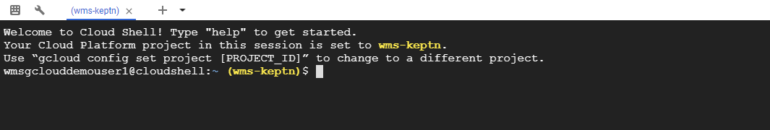
Setup our GKE Cluster – Launching Cloudshell
To launch and interact with our Kubernetes cluster we use Cloudshell
Cloudshell provides command-line access to your cloud resources directly from your browser
No need for a separate bastion host
Required tools pre-installed (git, docker, kubectl, etc…)
Persistent storage

Slide 14
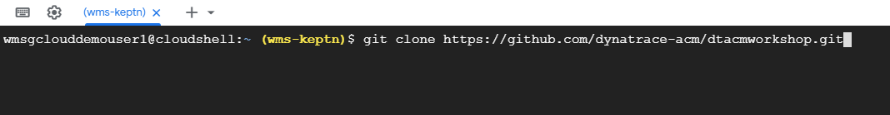
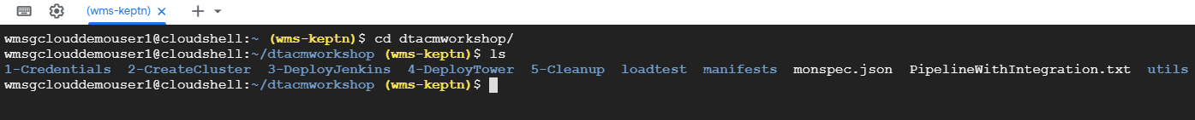
Setup our GKE Cluster – Cloning our repository
In Cloudshell, clone/download the following GitHub Repository:
https://github.com/dynatrace-acm/dtacmworkshop
This will create a folder called dtacmworkshop
This will contain the scripts we will use for the remainder of the workshop

Slide 15
Dynatrace Credentials – Tenant ID & Environment ID
In order to proceed further we need to make note of our Dynatrace Tenant/Environment and API/PaaS Tokens
For the Tenant ID, you can find it in the first part of your URL
https://<TENANT_ID>.live.dynatrace.com – SaaS Deployments
For example, for https://jwx05250.live.dynatrace.com , Tenant ID=jwx05250
https://<TENANT_ID>.dynatrace-managed.com
For example, for https://abc123.Dynatrace-managed.com, Tenant ID=abc123
The Environment ID is only applicable for Dynatrace Managed Deployments. You can find this value in the second half of your URL
https://<TENANT_ID>.dynatrace-managed.com/e/<ENVIRONMENT_ID>
For example, for https://abc1234.Dynatrace-managed.com/e/1234-5678, Environment ID=1234-5678

Slide 16
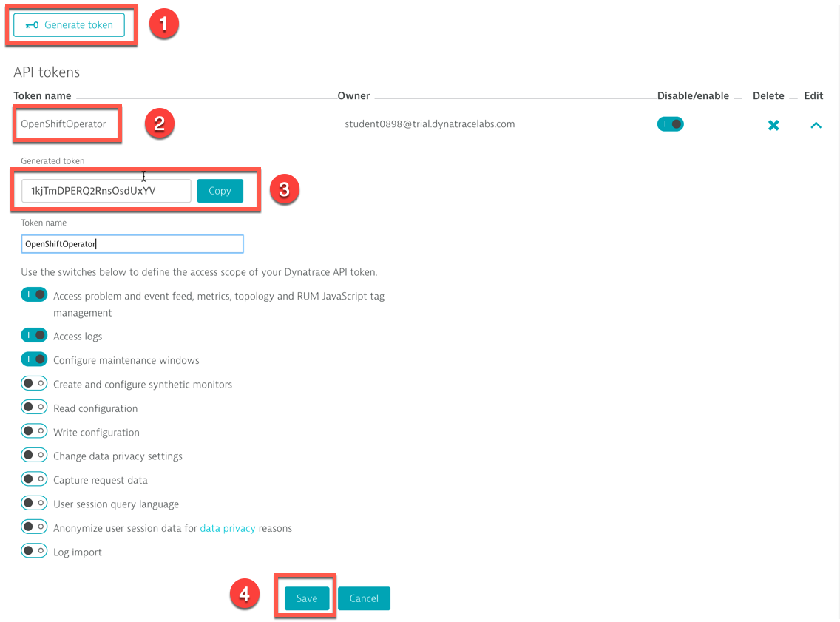
Dynatrace Credentials – API Token
Go in Settings -> Integration -> Dynatrace API
Click on Generate Token
Enter a name for your token (e.g. GKE)
Don't forget to click on the Save button

Slide 17
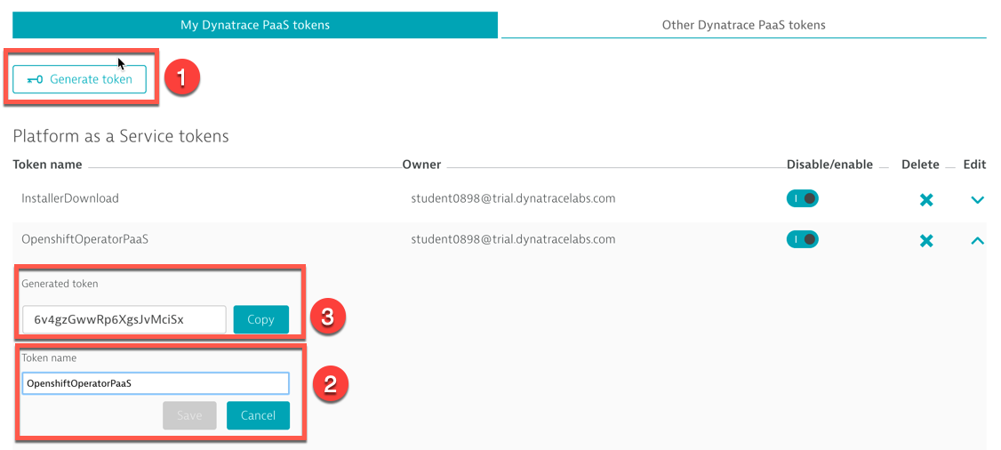
Dynatrace Credentials – PaaS Token
Go in Settings -> Integration -> Platform as a Service
Either copy the existing InstallerDownload token or click on Generate Token
Enter a name for your token (e.g. GKE), click Save

Slide 18
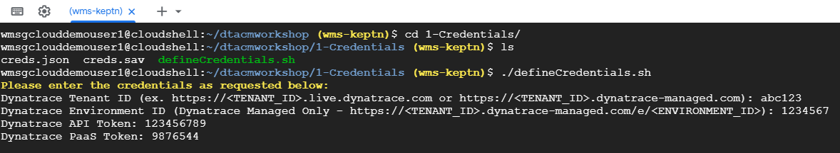
Creating our Credentials
We now need to store a local copy of our Dynatrace Tenant and API info for use when creating our cluster
Navigate to the directory 1-Credentials and execute the script defineCredentials.sh
This will ask for your Dynatrace Tenant/Environment information as well as your API and PaaS tokens
These values can be obtained from your Dynatrace tenant (see previous slides)
Once you have entered the values and confirmed they are correct, we can move on to creating our cluster

Slide 19
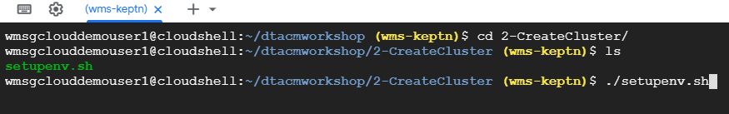
Setup our GKE Cluster
Back in your GCP account, launch a Cloudshell session
Navigate to the directory 2-CreateCluster
Execute the script setupenv.sh and confirm that your credentials are correct
This step will take about 10 minutes to complete

Slide 20
Setup our GKE Cluster
The setupenv.sh script will do the following:
Create a new GKE cluster
Deploy the Dynatrace OneAgent Operator to the cluster
Deploy the SockShop application to our cluster
Including creating the required Namespaces, storage objects and LoadBalancers

Slide 21
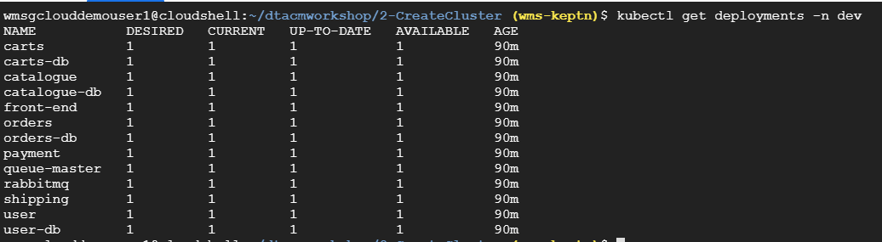
Validate our Cluster setup
After about 10 minutes since running the setupenv.sh script, let’s verify that everything is up and running
Let’s check and make sure our Deployments are Ready, run the following command in Cloudshell:
kubectl get svc –n dev -o wide
Note: This can also be validated in the GKE Console by selecting “Workloads” from the menu on the left side of the screen

Slide 22
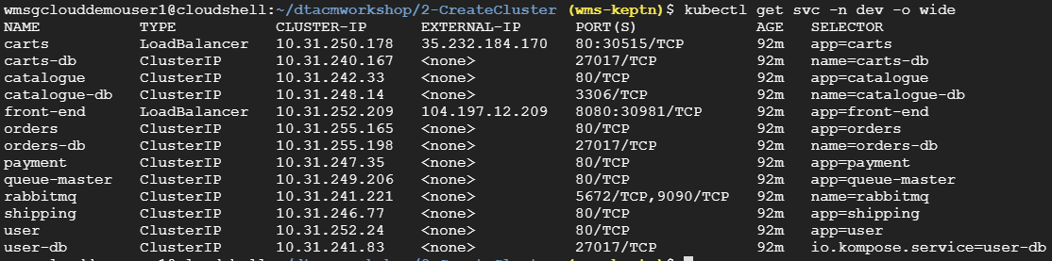
Validate our Cluster setup
Lets ensure that the SockShop application services are also created by running the following command:
$kubectl get svc –n dev -o wide
Our Carts and Front-end services should have External-IP addresses assigned
Note: This can also be validated in the GKE Console by selecting “Services & Ingress” from the menu on the left side of the screen

Slide 23
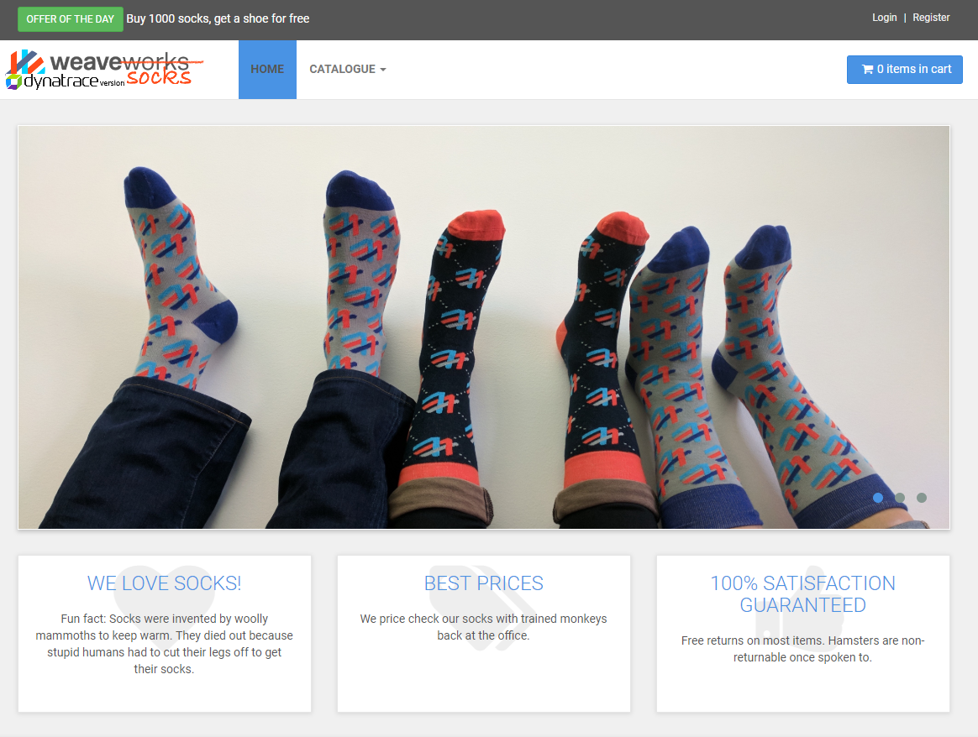
Validate our Cluster setup
Let’s launch our application in a web browser by copying and pasting the External-IP and Port of the front-end service. In the previous example it would be: http://104.197.12.209:8080
The SockShop homepage should appear in
your browser

Slide 24
Clean up script placeholder
In Terminal/Cloudshell execute the script: cleanup.sh
This will remove the dev, production and istio-system namespaces (and their associated objects) so we have a clean cluster
After this completes, we will redeploy the sock shop application in the dev namespace. We only need to execute the script: deploy-sockshop.sh and then wait a few minutes
Then check if the SockShop app is back up and running
$kubectl get svc –n dev -o wide

Slide 25
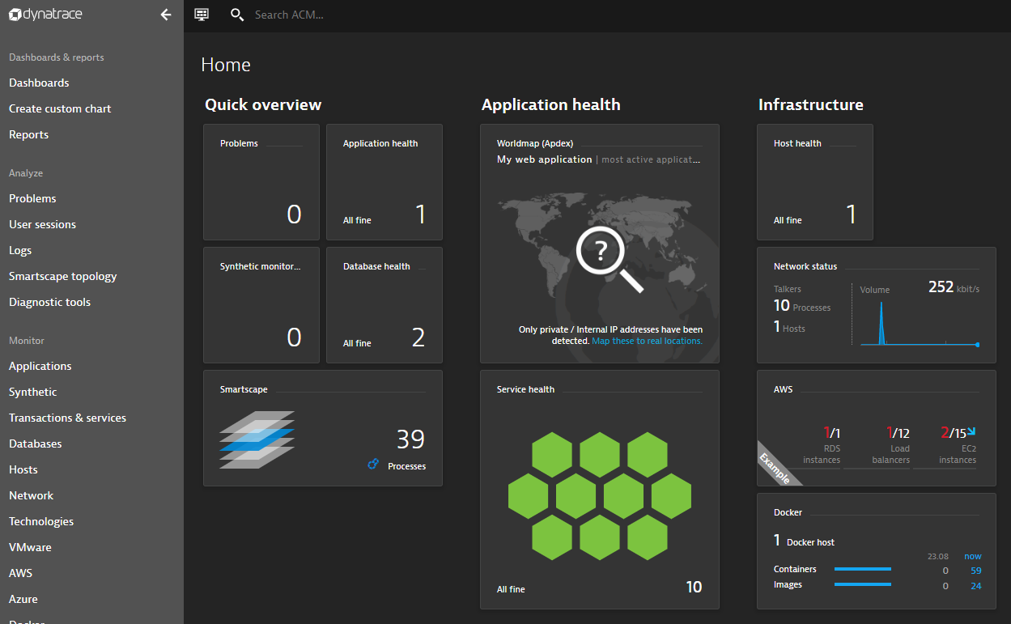
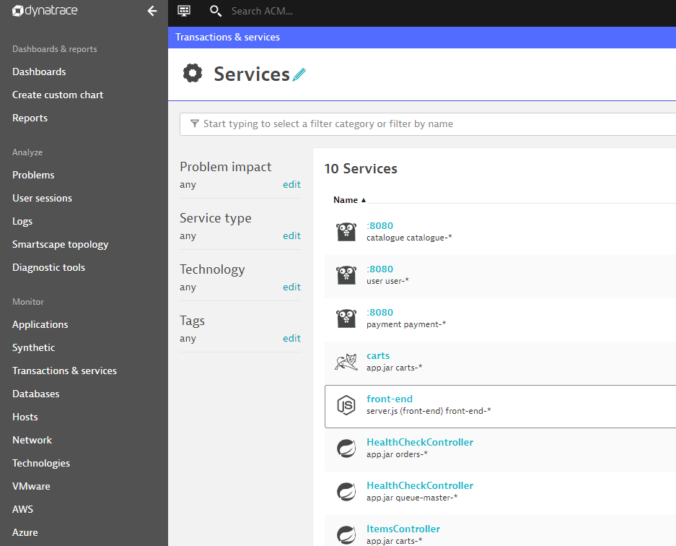
Validate Dynatrace
Now that we know our application is deployed and running successfully, we can validate that everything is being displayed in Dynatrace
Navigate back to Dynatrace and you should see data for Host, Process and Services

Slide 26
Deploying Jenkins

Slide 27
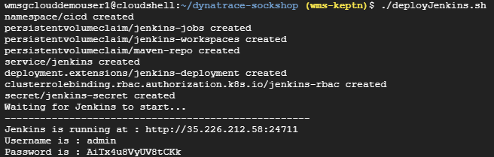
Deploy Jenkins
In Terminal/Cloudshell execute the script: deployJenkins.sh in the directory 3-DeployJenkins
This will deploy and startup Jenkins, import our pipeline and output the credentials
Note: You should change the default password!

Slide 28
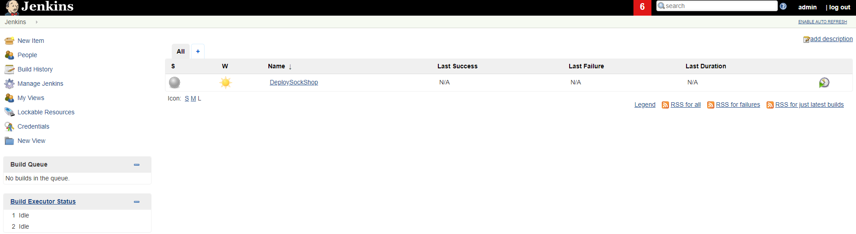
Jenkins Setup
After Jenkins has successfully deployed, navigate to the Jenkins URL and login with the previously provided username and password (again, recommend you change the password ☺

Slide 29
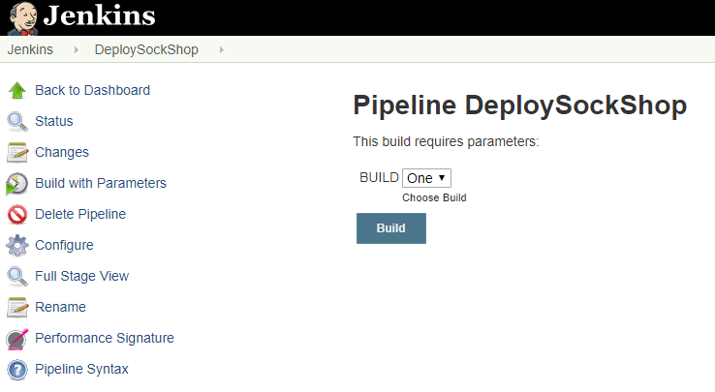
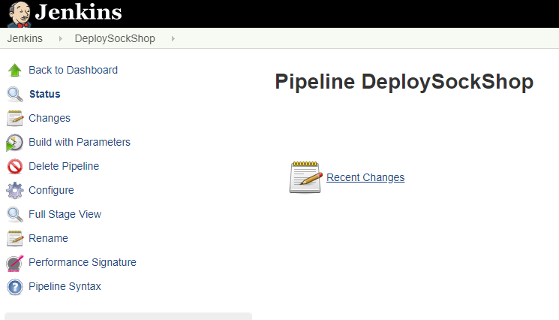
Run our first pipeline
On the Jenkins main screen we should see the “DeploySockShop” pipeline, select the pipeline by clicking it
Click Build with Parameters
Select Build “One” and Build

Slide 30
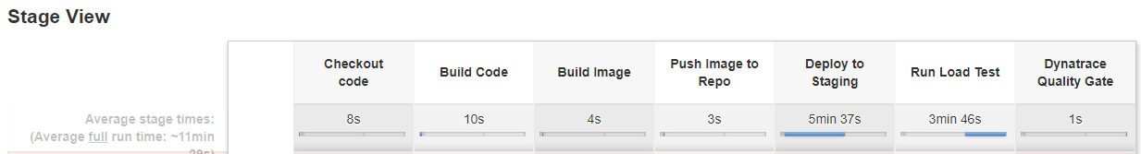
If all goes well…
The pipeline should run successfully (Note: this will take about 10 min)

Slide 31
Dynatrace Integration

Slide 32
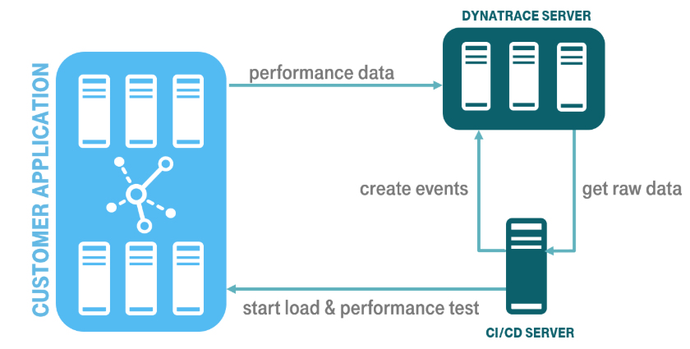
Dynatrace Integration
GitHub Repo and Example: https://github.com/jenkinsci/performance-signature-dynatrace-plugin/blob/master/README.md
Integration via the Dynatrace APIs (Timeseries and Events)
Based on a Performance Signature of a release (monspec)

Slide 33
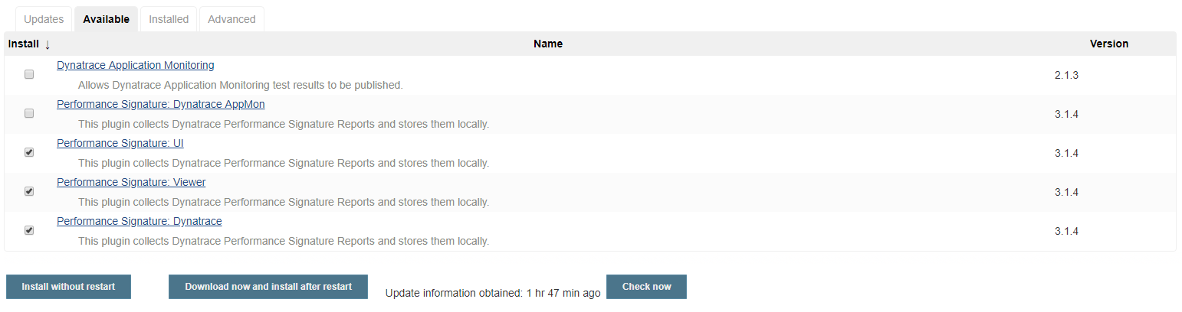
Install Jenkins Plugin
Navigate to Manage Jenkins -> Manage Plugins page and switch to the Available tab. Search for the "Dynatrace" keyword, select the 3 options below and click “Install without restart”.

Slide 34
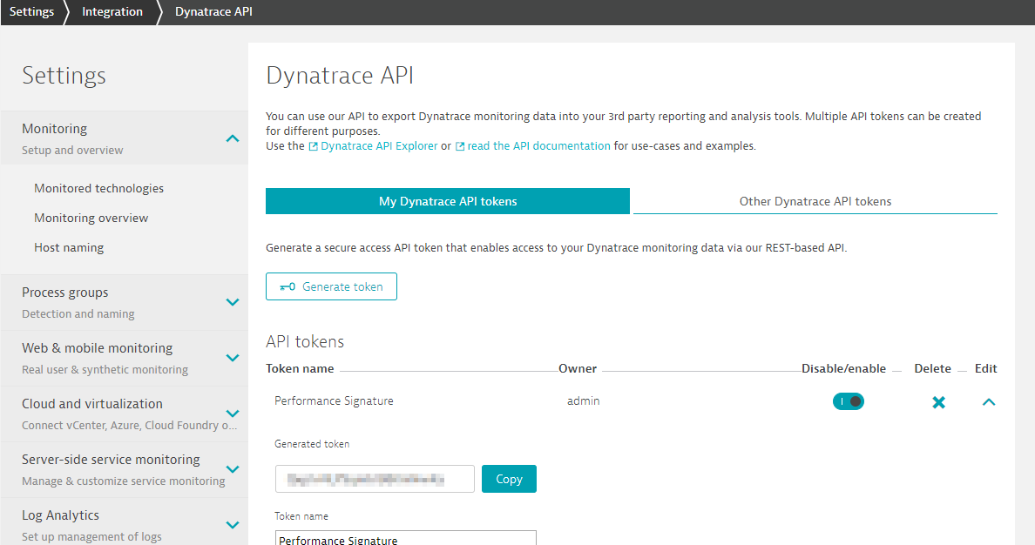
Dynatrace API
A Dynatrace API Token is needed for the Integration (Settings -> Integration -> Dynatrace API)
Only need the default top 3 permissions (This can be the same API Token as created in earlier steps)

Slide 35
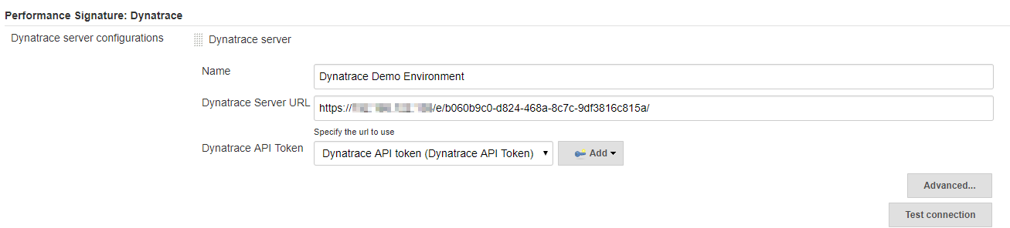
Jenkins Configuration
Navigate to Manage Jenkins -> Configure System -> Performance Signature: Dynatrace SaaS/Managed
Enter name of the
Server (ex. Dynatrace Server)
Your Tenant URL (https://xxxxxxxx.live.dynatrace.com) – SaaS, (https://asdfa.Dynatrace-managed.com/e/asdfafa) - Managed
API Token
Note: You many need to Save and exit this screen and come back for the “Add” dropdown to works, thanks to a bug in Jenkins
Test the Connection and Save

Slide 36
Adding Events to our Pipeline
There are three main events we will be adding to our Deployment Pipeline:
createDynatraceDeploymentEvent – Sends the Deployment Event to Dynatrace
recordDynatrace Session – Sets start/end time for when Perf Test beings
perfSigDynatraceReports – Queries all the metrics during the perf test timeframe and compares against the spec file. If metrics violate the spec file, the pipeline stage is failed

Slide 37
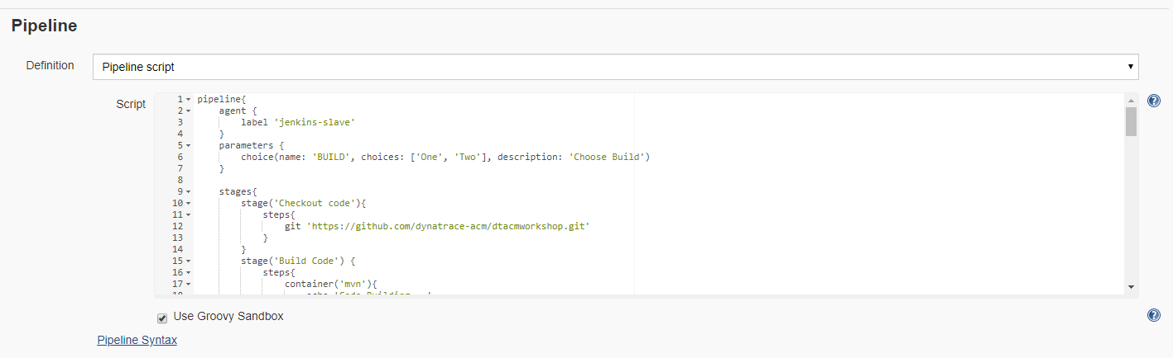
Adding Events to our Pipeline
In the DeploySockShop pipeline, click “Configure” and scroll down to the Pipeline script

Slide 38
Adding Events to our Pipeline – Deployment Events
First we want to add a Deployment Event to our Pipeline so every time we deploy our build to staging, Dynatrace will know about it

Slide 39
Adding Events to our Pipeline – Record Perf Test
Next we want to wrap our Loadtest stage with the recordDynatraceSession function, so we know when tests start and stop

Slide 40
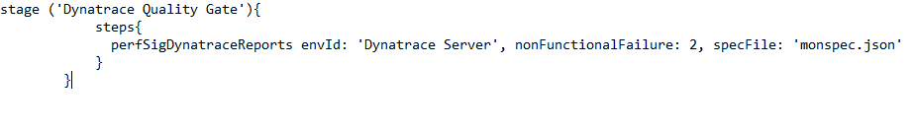
Adding Events to our Pipeline – Compare results to monspec
After the load test is completed, we want to validate the test against our monspec file (see next slide), to determine if our build meets quality or not
Add the below stage (“Dynatrace Quality Gate”) to the very end of our pipeline

Slide 41
Sample Monspec File
{
"spec_version": "2.0",
"timeseries": [{
"timeseriesId": "com.dynatrace.builtin:service.responsetime",
"aggregation": "avg",
"tags": “[Kubernetes]app:carts,[Kubernetes]stage:dev",
"upperWarning": 1000,
"upperSevere": 3000
}
]
}

Slide 42
Adding Events to our Pipeline
Once the events are added to our Pipeline we can apply and save
Note: There is a sample Pipeline with the events already added in the root of the repository titled “PipelineWithIntegration.txt”
You can use this as a reference when editing your pipeline
Note: You will need to make sure you change the name of the Dynatrace Environment to the same thing as you named your connection earlier. This file uses the name “Dynatrace Server” as the Dynatrace Environment Name.

Slide 43
Let’s test our Integration

Slide 44
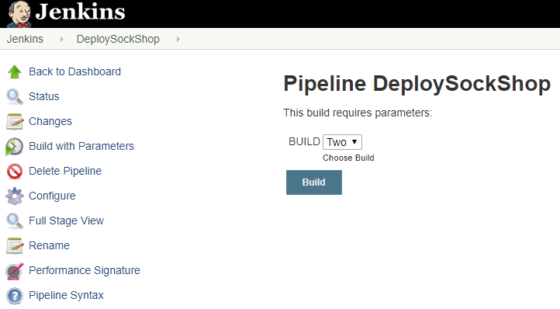
Deploy Build Two
After updating and saving our Pipeline to include the Dynatrace Performance Events, let’s re-run our pipeline with build Two
Select Build “Two” and Build

Slide 45
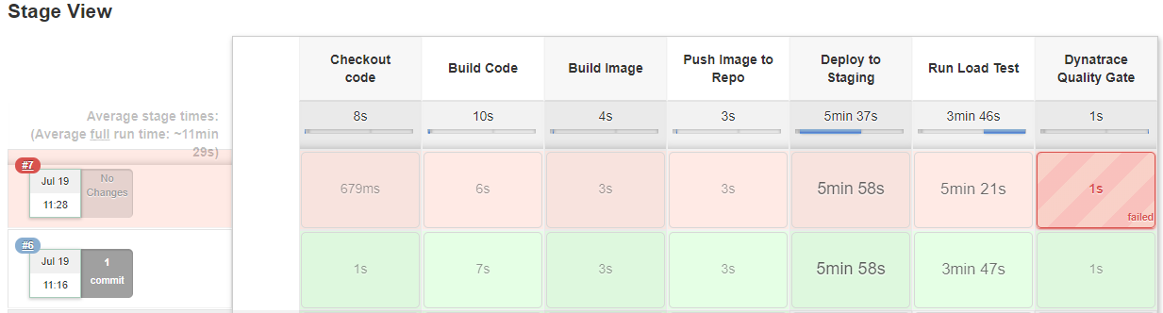
Now our build should fail

Slide 46
Redeploy Build One
If we redeploy using Build #1, this build should pass our Dynatrace Quality Gate
Select Build “One” and Build

Slide 47
Clean up

Slide 48
Clean up
If you want to just remove Jenkins and keep the cluster running, execute the script removeJenkins.sh contained in the GitHub Repository
If you want to delete everything, feel free to delete the GKE cluster via the GKE Console

